Slide 1
R
Operators

Slide 2
An operator
specific mathematical
logical manipulations.

Slide 3
Arithmetic Operators
Relational Operators
Logical Operators
Assignment Operators
Miscellaneous Operators

Slide 4
Arithmetic
v <- c( 2,5.5,6)
t <- c(8, 3, 4)
print(v+t)
+ , -, * , / ,
%%, (Give the remainder of the first vector with the second)
%/% (The result of division of first vector with second (quotient))
^ exponent

Slide 5
> v <- c( 2,5.5,6)
> t <- c(8, 3, 4)
> print(v%%t)
Note : Care on 2/8 ??

Slide 6
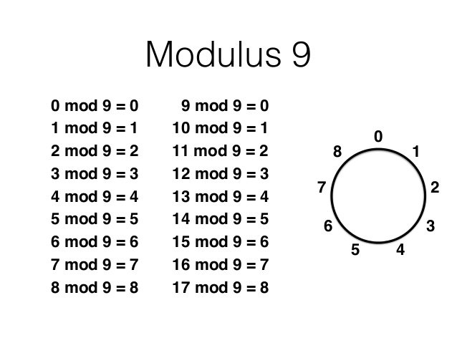
Modulus

Slide 7
Relational Operators (Comparision)
>
<
>=
<=
==
!=
Output as Boolean ( True/False

Slide 8
Logical Operators
And = &
Or = |
Not = !
It is applicable only to vectors of type logical, numeric or complex.
All numbers greater than 1 are considered as logical value TRUE.
(OR | ) Note: TRUE if one the elements is TRUE.

Slide 9
Assignment Operators
<=
=
<<-
Left Assignment
Right Assignment
->
->>

Slide 10
Miscellaneous Operators
: Colon v <- 2:8
%in% identify if an element belongs to a vector.
%*% - Multiply

Slide 11
